Slide 1
Welcome to Ms. Costello’s 5th Grade Class
Room 218
School 5 – Yonkers, New York September 23, 2021

Slide 2
Class Schedule
Our day begins as soon as students enter at 8:35
8:35-8:50 – Do Now (writing assignment) / Review/HW Attendance
8:50-11:00 – ELA Block
11:00-12:00 Small Group Instruction
12:00-1:00– Lunch/Recess
1:00-2:00– Math
2:00-2:50 – Science/Social Studies
2:50-3:10 – Reading and Reading Response
- Pack up, Bus Dismissal
3:15 – Walkers Dismissed

Slide 3
Special Classes :
Monday: Gym – 8:35-9:05
Tuesday: Music – 11:25-11:55
Wednesday: Art – 11:35-11:55
Thursday: Art – 8:35-9:05
Friday: Sub 1- 2:45-3:15

Slide 4
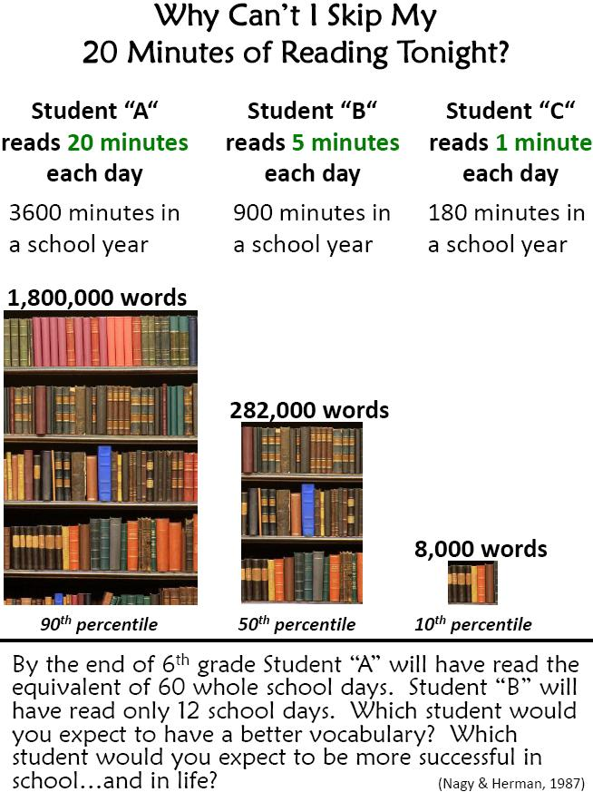
Children should read 20 minutes a day 5 days a week.

Slide 5
Ms. Costello’s Class
Class environment – We are family
Behavioral Expectations
Classroom Responsibilities
Homework responsibilities/ Purpose
Rubrics
Speed Tests – Unit Tests, Lesson Tests
Grading ABC and How grades are calculated
Scholastic Book Orders benefit our class

Slide 6
Homework
Homework is given Monday – Thursday and sometimes on Friday.
Please check your child’s homework notebook – organization is key
Students need to be responsible for their own work.
Homework is of little value when it’s late – We have already gone over the material.
Unit tests and other quizzes are sent home to be signed. This a homework assignment your child has been given…..sorry if they’re following you into the bathroom with a pen and paper ;)

Slide 7
Grading Policy
Grades are calculated using the following:
Projects/Tests – 50
Quizzes – 20%
Class work/Homework – 10%
Participation- 20%

Slide 8
Grading Scale
•A= 90-100
•B = 80-89
•C= 70-79
•D = 65-69
•F = 64 and Below

Slide 9
Next Generation Math Standards
5th Grade is a Step up from 4th
Methods have changed!
Online Component for remediation

Slide 10
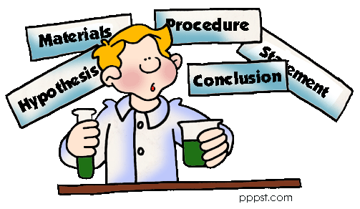
Departmentalized Social Studies/Science
Students will be working with Ms. Costello for Social Studies
Students will be working with Mrs. Hanrahan for Science
N.G.S.S. Next Generation Science Standards
We will be using a program called
“Mystery Science”
Each Mystery begins with a question that is explored through video and discussion questions
Uses video guided hands on investigations.

Slide 11
English Language Arts (ELA)
New Reading Program
Many components are online as well as in print
Made of small consumable reading magazines
*We do not have the first book yet;
We are starting the year reading: Frindle
Integrates Social Studies

Slide 12
School Policies
Our school day begins at 8:35 and ends at 3:15
It’s extremely important that students arrive on time and ready for their day (students should be well rested, have their supplies and homework)
The School Website can be found under K-8 schools on the Yonkers Public Schools website : www.yonkerspublicschools.org
My email is: Tcostello@yonkerspublicschools.org ****

Slide 13
Scholastic Book Orders
Class Code : J6Z23

Slide 14
Questions?
I am here to HELP
If you have any questions or concerns please call or email as soon as possible
Thank you for coming to Back to School Night

